Slide 1
Azure HDInsight
Rohit Shrestha
[Rohit@brainworks.edu.np]
Notes:
1

Slide 2



Azure HDInsight
Microsoft Azure’s big-data solution using Hadoop
Open-source framework for storing and analyzing massive amounts of data on clusters built from commodity hardware
Uses Hadoop Distributed File System (HDFS) for storage
Employs the open-source Hortonworks Data Platform implementation of Hadoop
Includes Hive, Pig, Storm, Spark, and more
Integrates with popular BI tools
Includes Power BI, Excel, SSAS, SSRS, Tableau
Notes:
Apache Hive is a data warehouse infrastructure built on top of Hadoop for providing data summarization, query, and analysis. Initially developed by Facebook, Apache Hive is now used and developed by other companies such as Netflix. Amazon maintains a software fork of Apache Hive that is included in Amazon Elastic MapReduce on Amazon Web Services
NOTE: Removed “Linux and Windows because of Spark’s decision to remove Windows support. Probably worth de-emphasizing the OS and instead focusing on the HDI platforms offered.
1

Slide 3
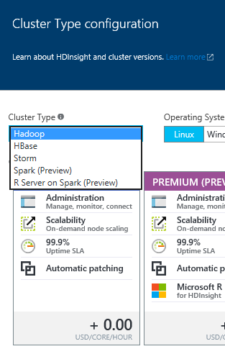
HDInsight Cluster Types
Hadoop: Query workloads
Reliable data storage, simple MapReduce
HBase: NoSQL workloads
Distributed database offering random access to large amounts of data
Apache Storm: Stream workloads
Real-time analysis of moving data streams
Apache Spark: High-performance workloads
In-memory parallel processing

Slide 4

Apache Spark
Interactive manipulation and visualization of data
Scala, Python, and R Interactive Shells
Jupyter Notebook with PySpark (Python) and Spark (Scala) kernels provide in-browser interaction
Unified platform for processing multiple workloads
Real-time processing, Machine Learning, Stream Analytics, Interactive Querying, Graphing
Leverages in-memory processing for really big data
Resilient distributed datasets (RDDs)
APIs for processing large datasets
Up to 100x faster than Hadoop
Notes:
1

Slide 5
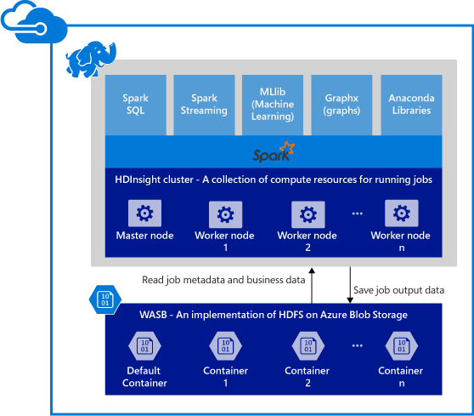
Spark Components on HDInsight
Spark Core
Includes Spark SQL, Spark Streaming, GraphX, and MLlib
Anaconda
Livy
Jupyter Notebooks
ODBC Driver for connecting from BI tools (Power BI, Tableau)

Slide 6
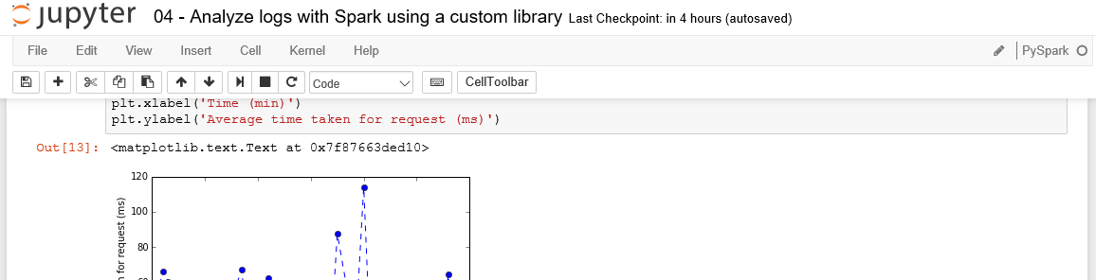
Jupyter Notebooks on HDInsight
Browser-based interface for working with text, code, equations, plots, graphics, and interactive controls in a single document.
Include preset Spark and Hive contexts (sc and sqlContext)

Slide 7

Demo
jk

